Slide 1

A Geo-Location-Based Platform for Connecting Users with Skilled Professionals Using Mobile Application
Presentation on
Presenter:
Md Mominur Rahaman
Program: B.Sc. in CSE
ID: 0322210105101511
Department of Computer Science & Engineering
Pundra University of Science & Technology, Bogura – 5800

Slide 2
A Geo-Location-Based Platform for Connecting Users with Skilled Professionals Using Mobile Application
Presentation on
Presented By
Supervised By
Md Mominur Rahaman
Program: B.Sc. in CSE (Diploma)
ID: 0322210105101511
Batch: 14th
Semester: 8th
Session: Spring- 2022
Mst. Sahela Rahman
Lecturer
Dept. of CSE, PUB

Slide 3
Outline
Introduction
Problem Statement
Feasibility Study
Objectives
Proposed Methodology
Key Features
Activity Diagram
Use Case Diagram
Entity-Relationship Diagram
Data Flow Diagram(DFD)
11.Tools & Technologies
12. Expected Outcomes
13. References

Slide 4
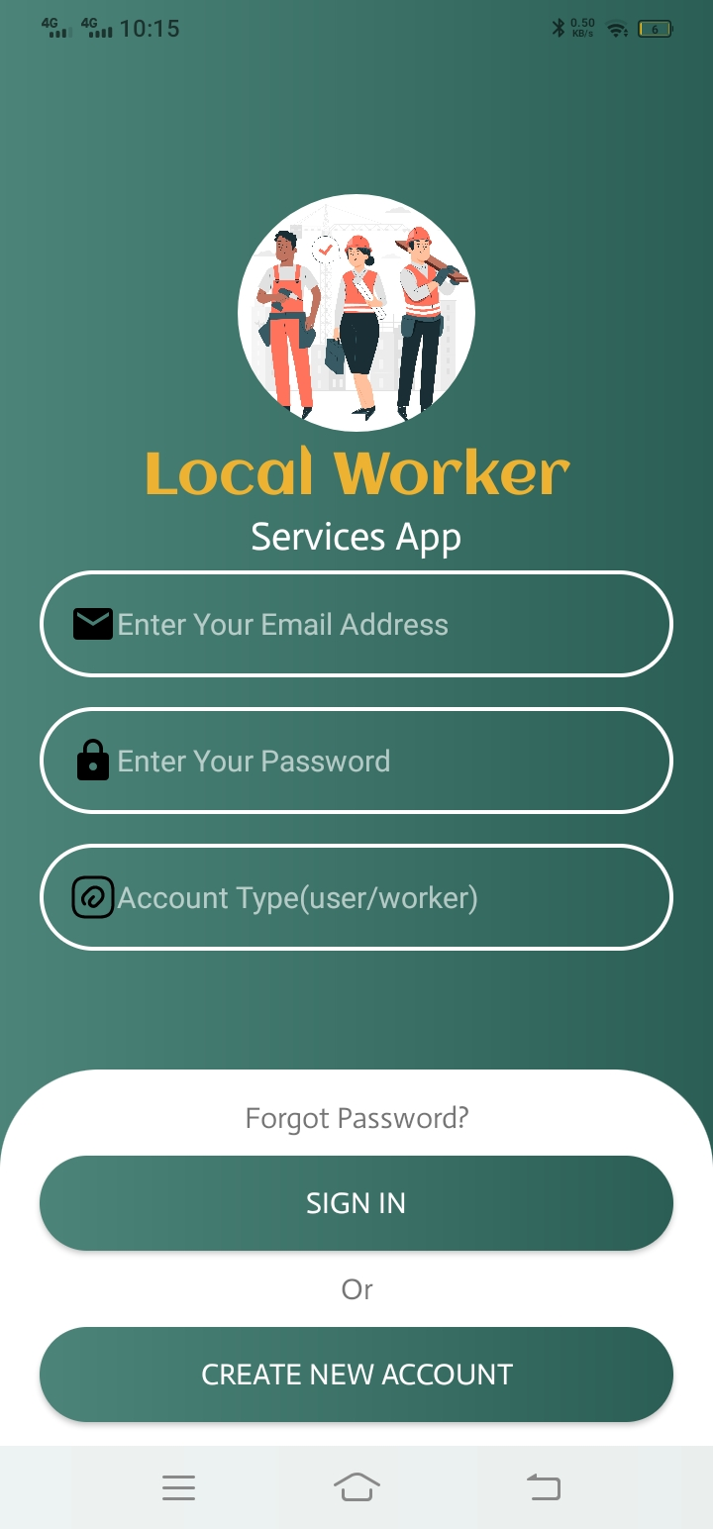
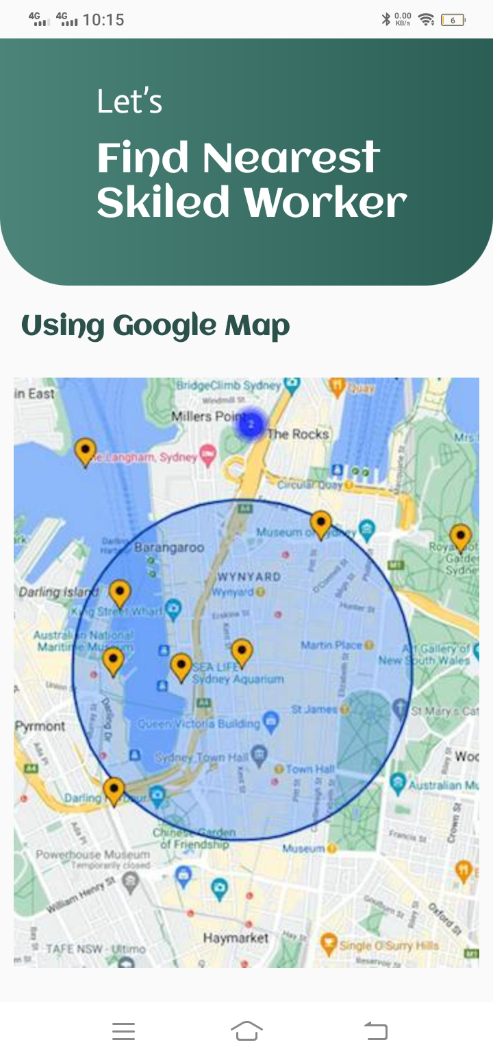
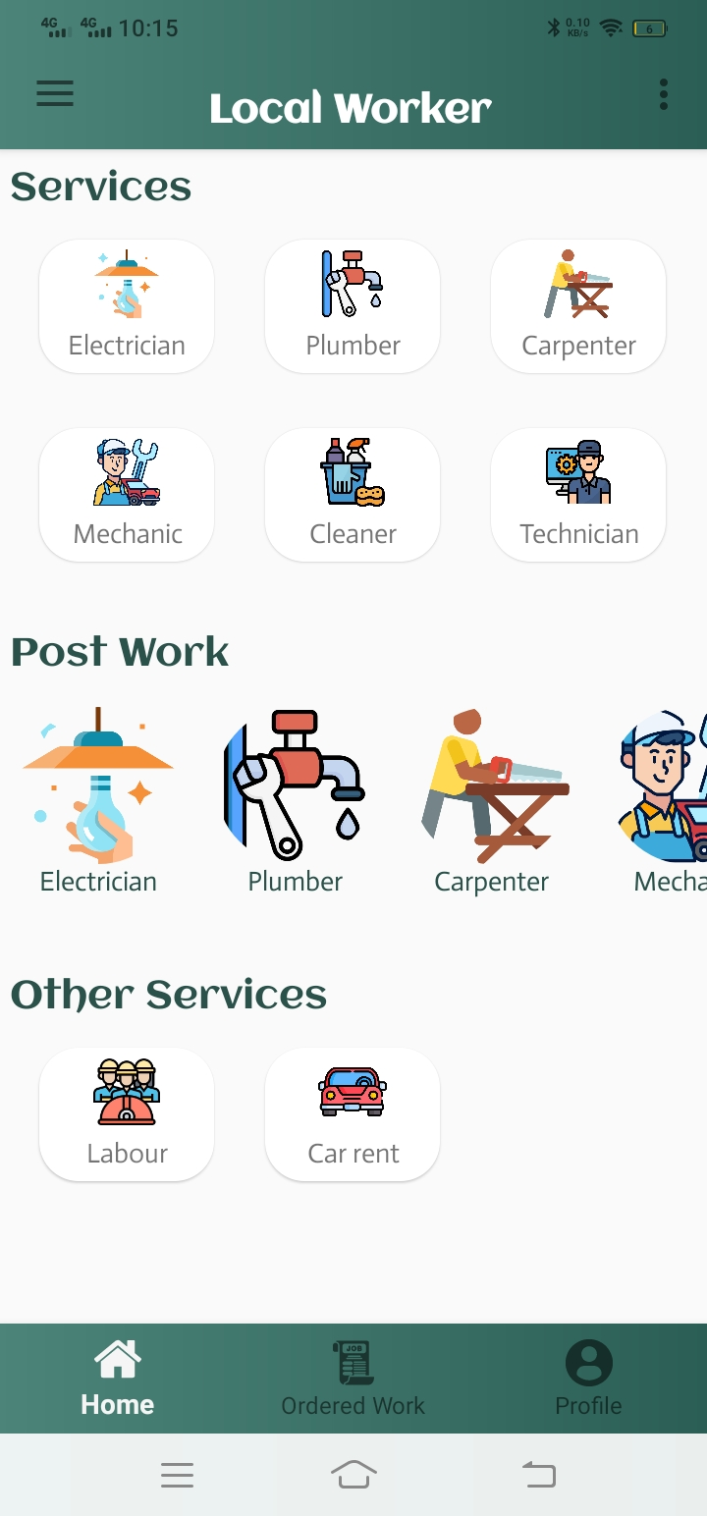
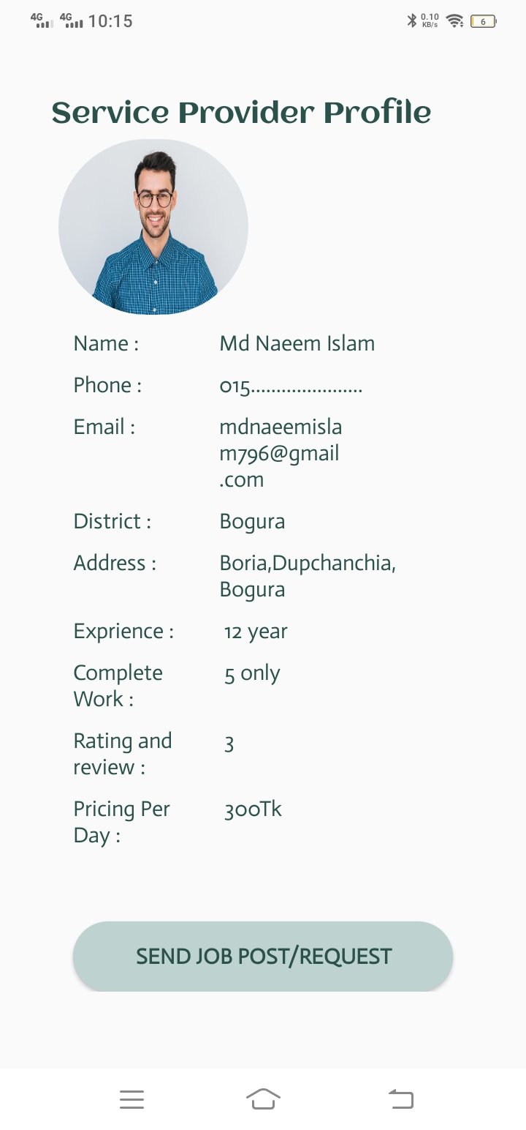
Introduction
This project aims to create a mobile application that helps users find skilled professionals nearby using geo-location technology. Many people struggle to find reliable professionals like electricians, plumbers, or tutors in their area. This app will solve this problem by connecting users with nearby professionals quickly and easily.

Slide 5
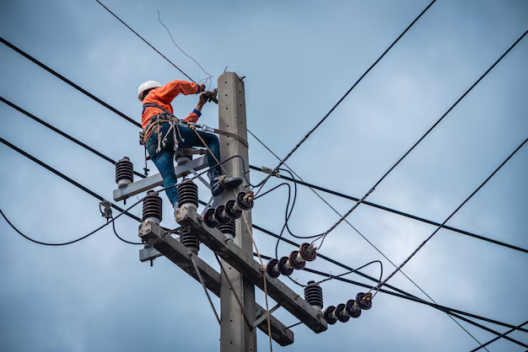

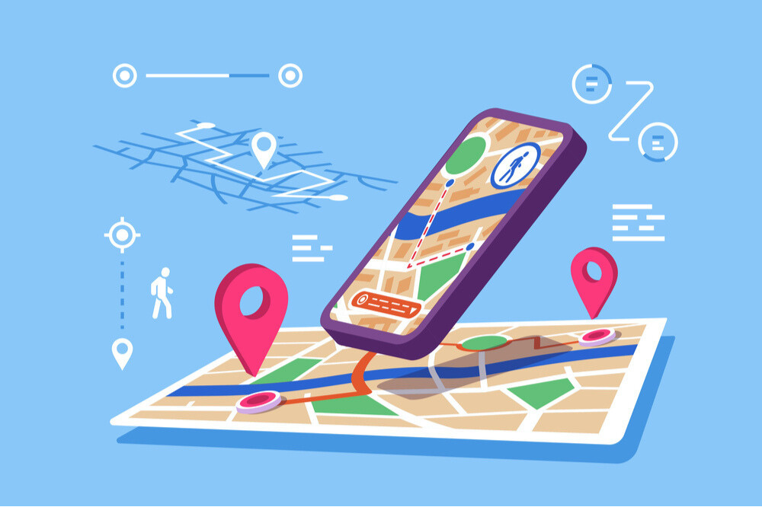
Problem Statement
Current Challenges:
Difficulty finding reliable skilled professionals (plumbers, tutors, electricians, etc.).
Existing platforms lack geo-location-specific features, causing inefficiencies.
Service providers struggle to reach local clients effectively.
Solution: A streamlined mobile app connecting users with nearby professionals in real time.

Slide 6



Feasibility Study
Market Feasibility (Will People Use This App?):
Rising demand for verified professionals (plumbing, electricians, tutors)
Economic Feasibility: Subscription plans for providers .
Technical Feasibility:
Android Studio, Java, and Firebase for scalable development.
Firebase offers real-time databases, authentication, and cloud functions.
Operational Feasibility: Intuitive UI for users and efficient management
tools for professionals.

Slide 7
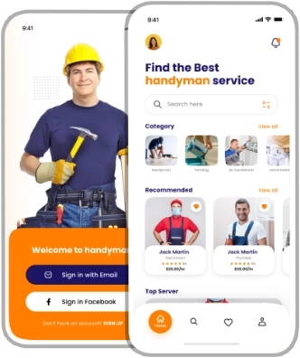
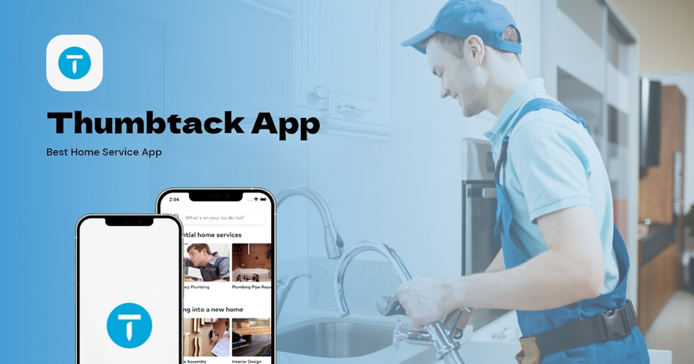
Existing Work
Thumbtack[1]: Matches users with local professionals for home services.
Limitation: No real-time tracking; relies on quote comparisons.
Handy[2] : Offers instant booking for cleaning and repairs.
Limitation: Narrow service range;

Slide 8
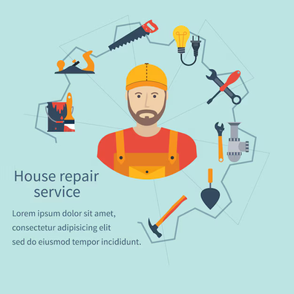


Objectives
Create a user-friendly platform for local service connections.
Enable real-time service tracking
Implement a transparent rating/review system.
Help service providers expand their reach and grow businesses.

Slide 9

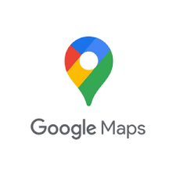



Proposed Methodology
Research: Surveys and analysis of existing platforms.
Design: Wireframes, prototypes, and Firebase database structure.
Development:
Front-end: Android Studio (Java).
Back-end: Firebase + Google Maps
API for location tracking
Testing: Each unit, integration, and user acceptance testing.
Launch & Marketing: Release on Google Play Store with regular updates

Slide 10
Key Features
For Users
Location-Based Search – Find nearby professionals.
Instant Booking – Schedule appointments in real-time.
Ratings & Reviews – Make informed decisions.
In-App Chat/Call – Direct communication.
For Professionals
Profile Management – Showcase skills, experience, and pricing.
Job Notifications – Get alerts for new requests.

Slide 11
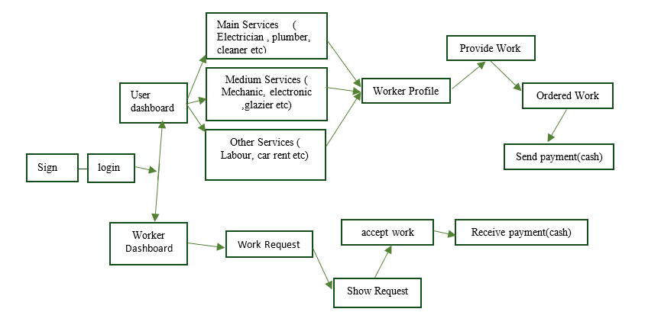
Activity Diagram

Slide 12
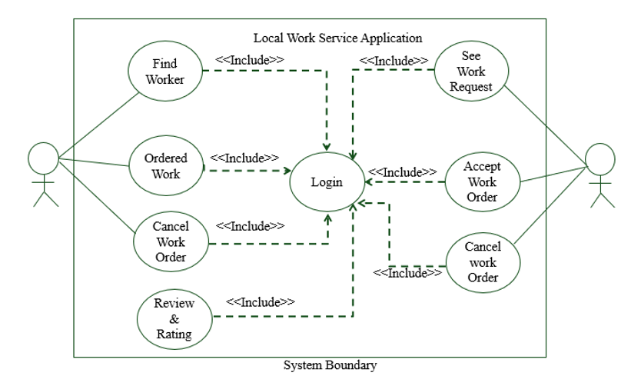
Use Case Diagram
Monday, January 5, 2026
Department of Computer Science & Engineering, PUB
12

Slide 13
Entity-Relationship Diagram
User NID
Name
Work Tittle
Phone
Email
Work ID
Work Details
Price
User
Provide
work
Work Request
YES / No
Address
User
Name
Worker
ID
User NID
Does
YES/NO
Work Tittle
Worker
ID
Worker
Name
Work ID
Work Details
Price
Review/Rating
Complete
Work
Skilled Worker
Work Accept
Rating
Review
User Address
Worker
ID
Work ID
User
Name
Schedule
Service
type
Worker
ID
Address
Email
Phone
User NID
Monday, January 5, 2026
Department of Computer Science & Engineering, PUB
13

Slide 14
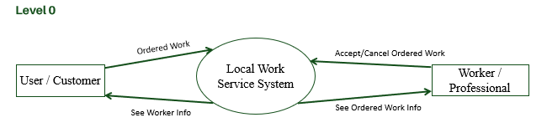
Data Flow Diagram(DFD
Monday, January 5, 2026
Department of Computer Science & Engineering, PUB
Monday, January 5, 2026
Department of Computer Science & Engineering, PUB
14
14

Slide 15
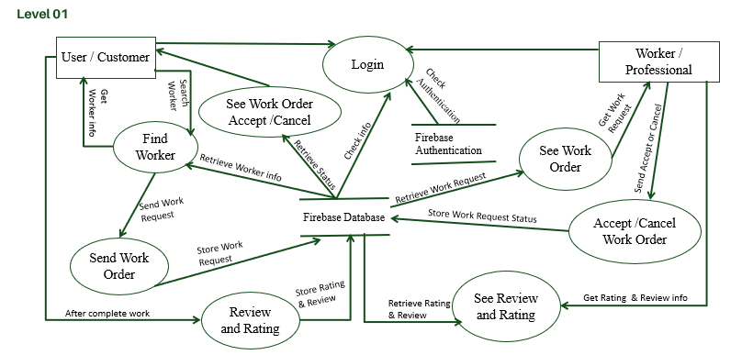
Data Flow Diagram(DFD)
Monday, January 5, 2026
Department of Computer Science & Engineering, PUB
Monday, January 5, 2026
Monday, January 5, 2026
Department of Computer Science & Engineering, PUB
Department of Computer Science & Engineering, PUB
15
15
15

Slide 16
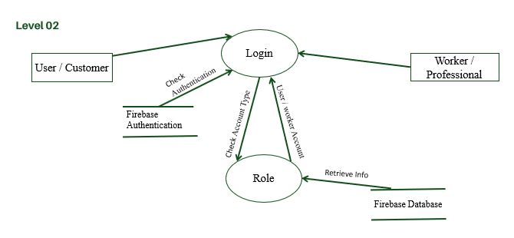
Data Flow Diagram(DFD
Monday, January 5, 2026
Department of Computer Science & Engineering, PUB
Monday, January 5, 2026
Monday, January 5, 2026
Monday, January 5, 2026
Department of Computer Science & Engineering, PUB
Department of Computer Science & Engineering, PUB
Department of Computer Science & Engineering, PUB
16
16
16
16

Slide 17
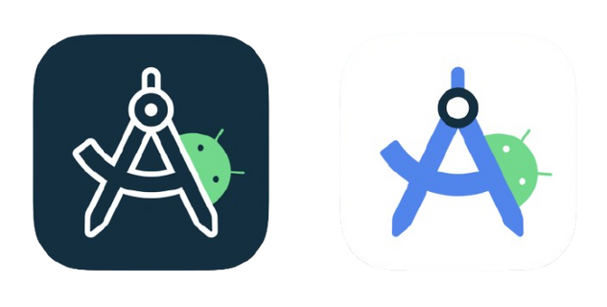

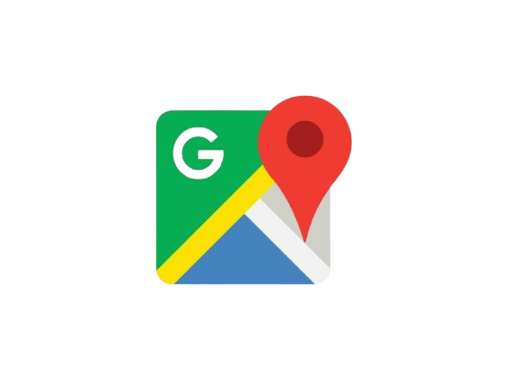
Tools & Technologies
Development: Android Studio, Java.
Back-end: Firebase (Auth, Realtime DB, Cloud Functions).
APIs: Google Maps, Payment Gateway .
Design/Version Control: Figma/Adobe XD, Git.

Slide 18
Expected Outcomes
A fully functional app for finding/hiring local professionals.
Improved accessibility and convenience for users.
Growth opportunities for service providers

Slide 19
References
1.“Firebase Documentation”[online]. Available : https://firebase.google.com/docs
2.“Android Studio”[online]. Available : https://developer.android.com/develop
3.“Google Map API Docs”[online]. Available : https://developers.google.com/maps/documentation
4.“Thumbtack: Hire Service Pros”[1].Available: https://play.google.com/store/apps/details?id=com.thumbtack.
5.“Handy - Book home services”[2].Available: https://play.google.com/store/apps/details?id=

Slide 20
THANK YOU!

